Slide 1

CODE RED 3.0
CODE TILL YOU DROP
OBJECTIVE :
“CashMate : To empower users to invest, control spending, save better and make informed financial decisions effortlessly.”
Problem Statement Code: CR(S)6
Team Name: 4codz
Team Leader Name: Syeda Zoya Ahmed
Institution Name: Atria Institute Of Technology

Slide 2

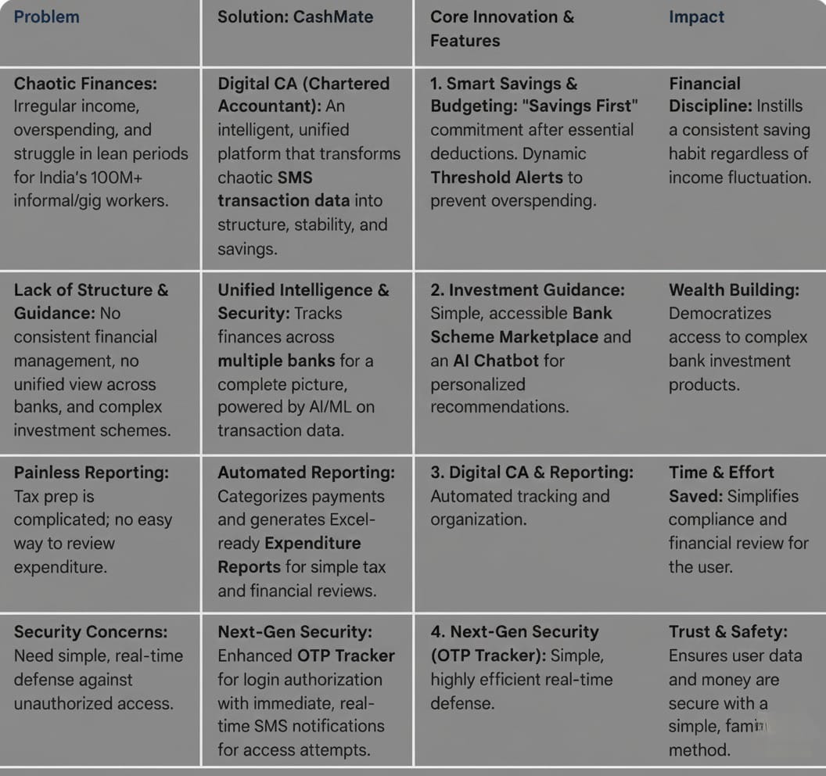
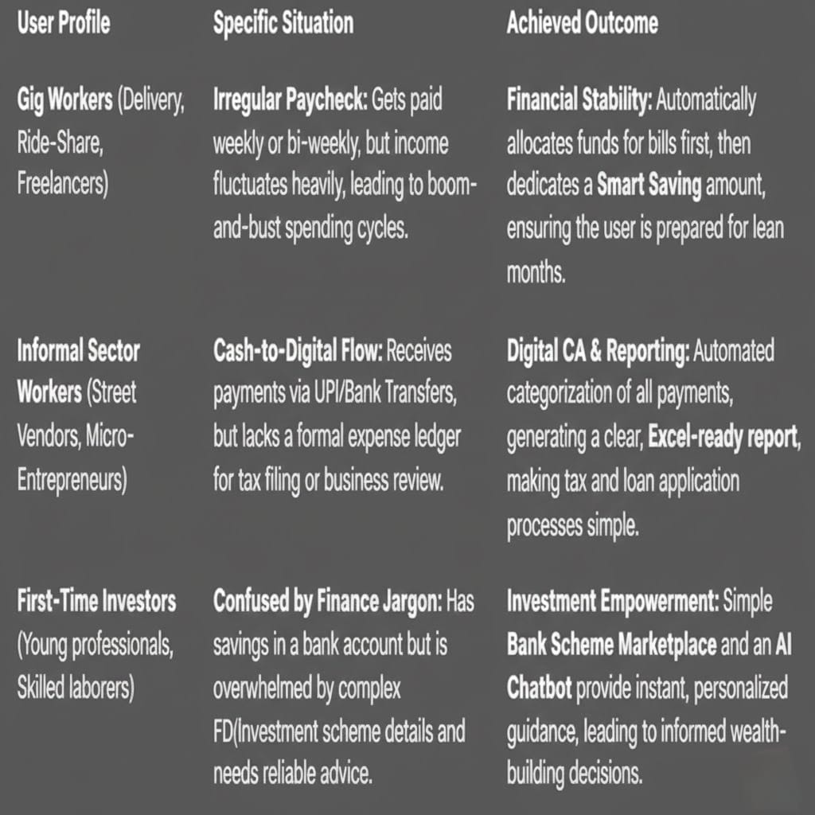
`
IDEA/APPROACH DETAILS
Idea/Solutions & Use Cases
familiar
familiar

Slide 3
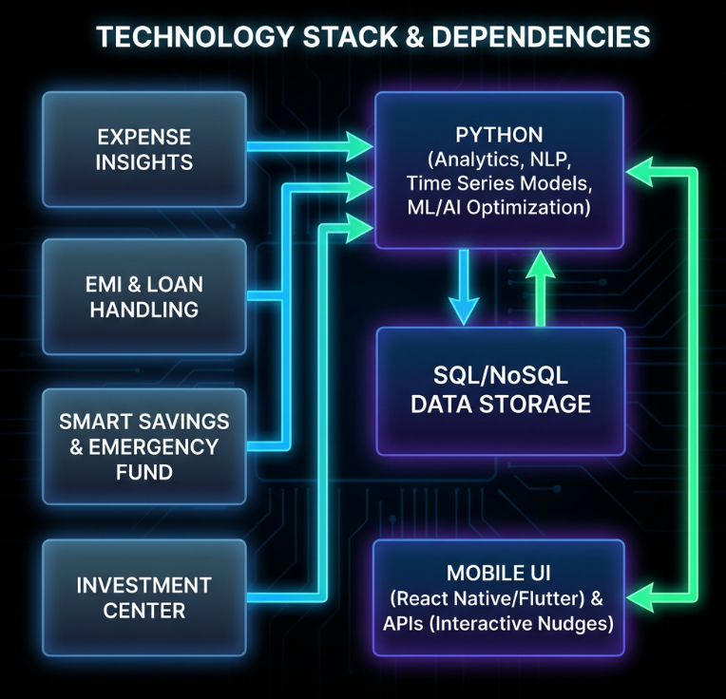
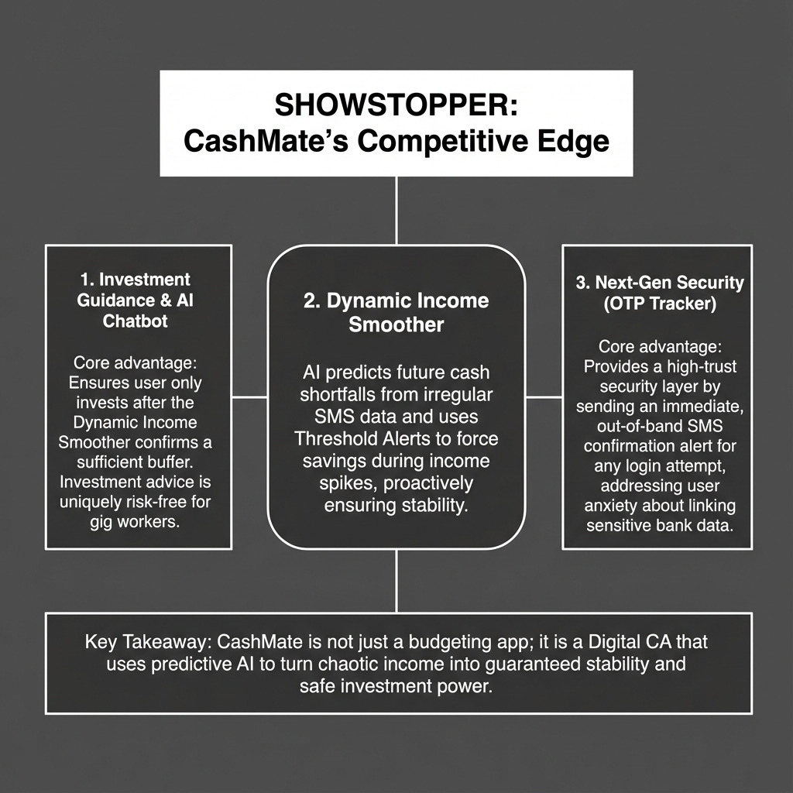
IDEA/APPROACH DETAILS
IDEA/APPROACH DETAILS

Slide 4
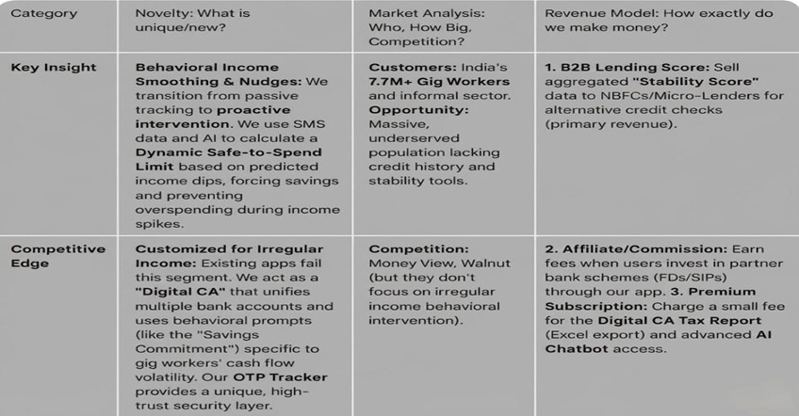
Novelty/ market analysis/revenue model
IDEA/APPROACH DETAILS

Slide 5
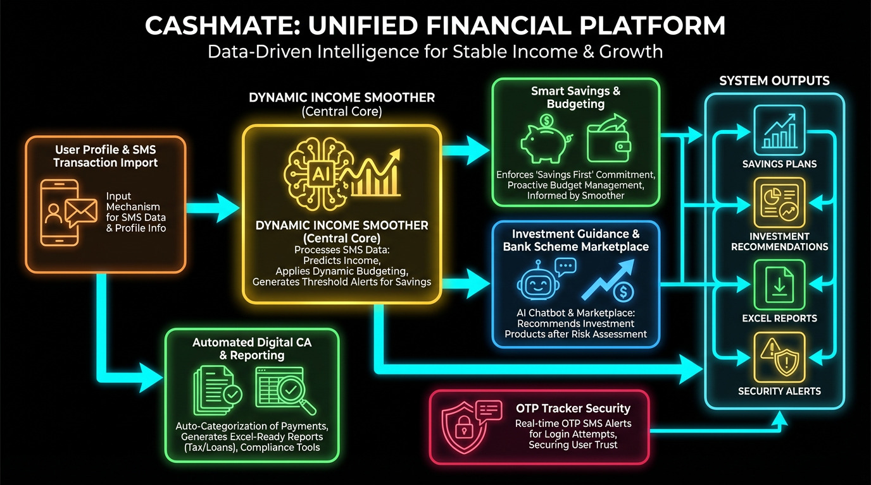
IDEA/APPROACH DETAILS
IDEA/APPROACH DETAILS

Slide 6
IDEA/APPROACH DETAILS
TEAM DETAILS
Team Leader Name: Syeda Zoya Ahmed
Student ID: 1AT24CS234
Institution Name: Atria Institute Of Technology
Phone Number: 9731761930
Email ID: zoya3042006@gmail.com
Member 1 Name : Dhanush N Ragi
Member 2 Name : Harshini D
Member 3 Name : Fardeen Iqbal Syed

